Slide 1
Community Detection In Attributed Graphs
Sheng Guan
Committee:
Assefaw Gebremedhin (chair)
Yinghui Wu
Venera Arnaoudova
Notes:
*
Template-WSU Hrz 431 gradation.ppt
1
Good morning, distinguished professors, thank you for attending my qualification exam. I’m Sheng Guan.
My topic is about community detection in attributed graph.

Slide 2
Outline
Introduction
Paper summary (CESNA[1])
Survey on community detection in attributed networks
Proposed research: Attribute-driven backbone discovery
Conclusion
1
Notes:
*
Template-WSU Hrz 431 gradation.ppt
2
The whole presentation consist of 5 parts. The first part I will give a brief background introduction.

Slide 3
Outline
Introduction
Paper summary(CESNA[1])
Survey on community detection in attributed networks
Attribute-driven backbone discovery
Conclusion
2
Notes:
*
Template-WSU Hrz 431 gradation.ppt
3

Slide 4

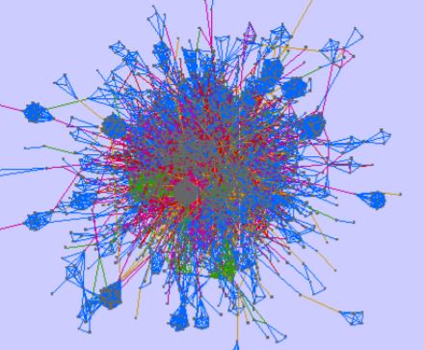
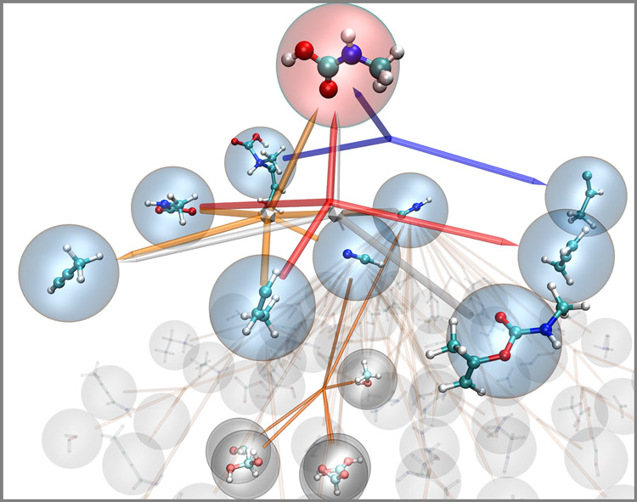
Introduction 1/5
Communities => functionality of the system
Social Network
Protein Network
Chemical reaction network
3
Notes:
In the social network, each node represents a community. The community often represent a group of people who share common hobbies or interestingness under the same topic.
In the protein-protein interaction network, different colors represent different communities. The community of proteins group together to stand for a functional module that normally is associated with a symptom.
In the chemical reaction network, the same color of edges connect a set of molecules.
They group together to perform a chemical reaction.
In a general form, in the graph network, we will be given G=(V,E), and the problem is to partition the node set to several communities. Each community actually stands for a functionality of the system.
*
Template-WSU Hrz 431 gradation.ppt
4

Slide 5
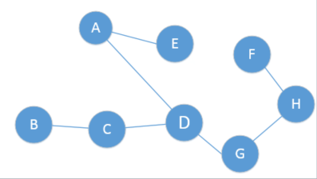
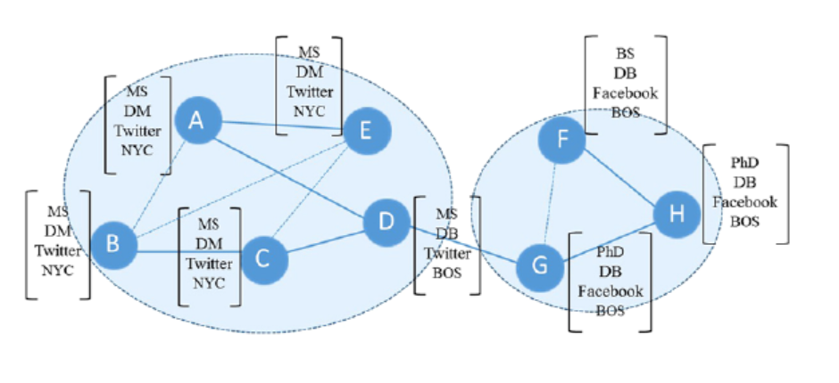
Introduction 2/5
Why we should consider the attributed graph?
Traditional community detection fails
Attribute => identify community in sparse network
Reprinted figure from [2]
4
Notes:
Attributed graph can help us identify some communities. In contrast, the traditional community methods rely on the dense structures and cannot return any community.

Slide 6
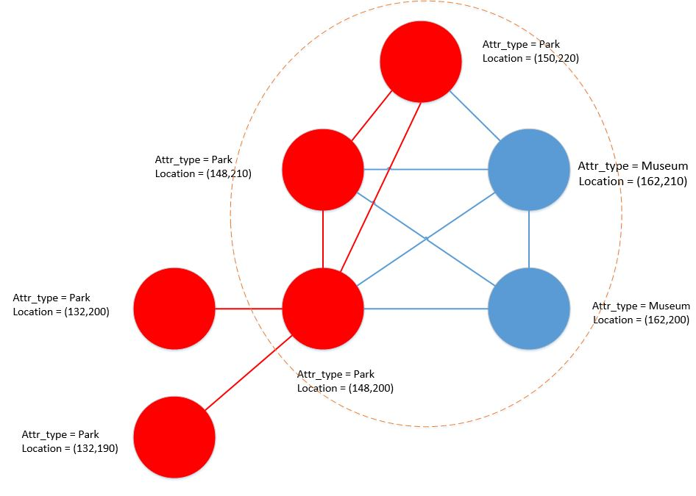
Introduction 3/5
Challenges 1: community differs based on attributes
A more precise community (semantic)
5
Notes:
Majority work neglects the attribute information
The traditional topology features based community detection methods, for examples, k-cores and k-cliques may not be suitable in the attributed-semantics.
For example, in the tour recommendation network, the traditional community will mine a 3-core based on degree information.
However, when the tourists would like to get route planning information according to the attribute value, e.g. Park tour, the community connected by red edges is a better community for recommendation.

Slide 7
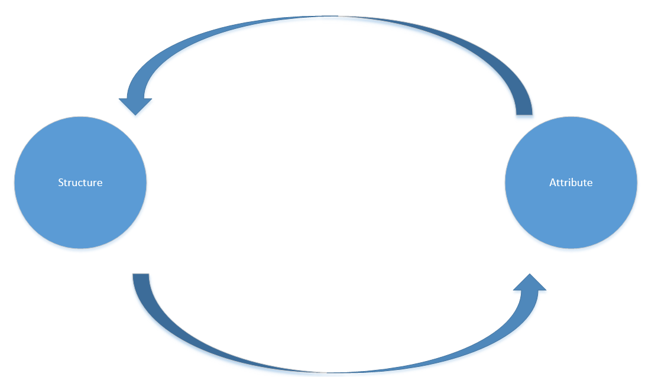
Introduction 4/5
Challenges 2: Interaction between structure and attributes
Only consider topology (degree, path, etc.)
Only consider attributes (similarity, distance, etc.)
6
Notes:
The observed dependency between memberships and attributes from the social science supports that community memberships generate both the graph and attributes. This view is also supported by real life experience. Consider you and me are friends. Community here would be a social friendship among certain people. Nodes here are persons and attributes here are characteristics of the person, for example , hobbies.
we normally will have a common hobby, for example, hiking or swimming. Conversely, because we share the common interest, such as hiking, we met and became friends.
Hence, the traditional community detection is not right when they consider each information independently.
But, how to model the interaction between structure and attributes interdepedently becomes a challenge.

Slide 8
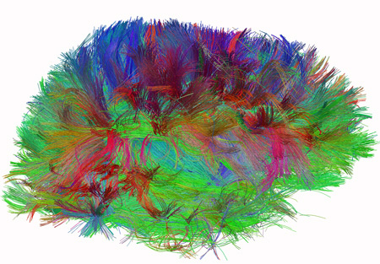
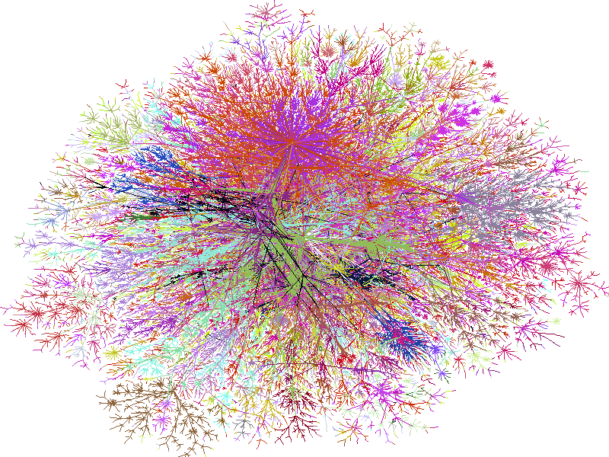
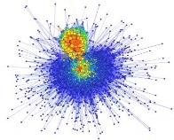
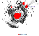
Introduction 5/5
Challenges 3: Scalability and “dirty” data
How to deal with massive graph size?
How to deal with dirty data and missing links?
2.7 hours over graph with 50,000 nodes
MAC[3], CODICIL[4]
100M(10⁸)
social scale
100B (10¹¹)
Web scale
1T (10¹²)
7
brain scale, 100T (10¹⁴)
Notes:
For example, the given two methods need 2.7 hours on graph network which only has 50,000 nodes, whereas in the real network, such as social network, the magnitude of the number of the vertices is around 100 billion. We can clearly see that there is a huge gap here.
At the same time, the community detection algorithm usually will assume that the given graph with attribute values are clean. Because the attribute value and edges between vertices have a impact on the clustering result. How to deal with graph that has missing links or incorrect values would become a challenge. We will discuss more about this when we give a survey about existing community detection algorithms.

Slide 9
Outline
Introduction
Paper summary(CESNA[1])
Survey on community detection in attributed networks
Attribute-driven backbone discovery
Conclusion
8
Notes:
*
Template-WSU Hrz 431 gradation.ppt
9
So, keep these 3 challenges in mind. I will discuss the CESNA paper to show how the methodology proposed in this paper can deal with the above challenges.

Slide 10
CESNA summary – 1/14
(Community Detection in Attributed Graph)
Problem Definition
Input:
attributed graph G: (V,E,X)
Output:
Partition P: V
9
Notes:
Before we jump into the details of the methodology, we first give a problem definition about community detection in Attributed Graph.
F: community memberships that indicates the probability of a node belongs to certain communities.
The attributed community detection problem is to partition the vertex set V into C subsets, P= {P1, P2 , …, PC}
Vertices within the same community are densely connected, while the vertices in different communities are sparsely connected
Vertices in the same community are expected to have similar/homogeneous attributes

Slide 11
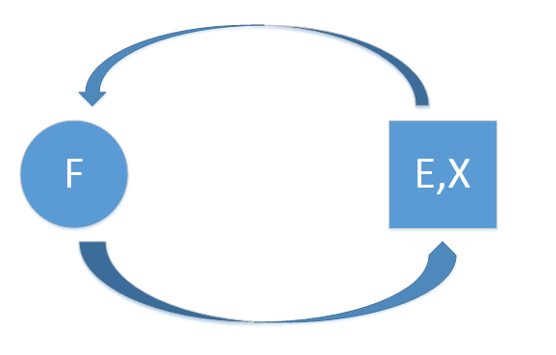
CESNA summary – 2/14
Community Detection in Networks with Node Attributes (CESNA) Key Idea
node community membership<->edges
node community membership<->attributes
10
Notes:
In this paper, the key idea is to model the interaction between the graph structure and node attributes. To model the interaction, they use a latent variable called community membership.
The authors leverage the idea that we talked before. The community membership can generate attribute values and graph link probability at the same time.
For example, if you and me are friends and we are in the same community, which means we share the common hobbies like hiking and we are connected by an edge to indicate the friendship. At the same time, if we are connected with an edge and share the common attribute, like hiking. We will be expected in the same community.

Slide 12
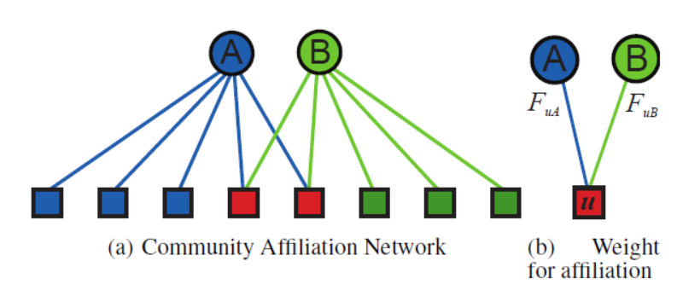
CESNA summary – 3/14
CESNA probabilistic generative model
$$°$$
Reprinted figure from [5]
B(V,C,M) => G(V,E,X,F) M is the edges in bipartite graph
11
Notes:
Fuc =[0,+∞), Fuc= 0 means node u does not belong to community c
The value of FuA indicates the closeness of a node u belongs to a community A.
Then, after we build the bipartite graph B, we try to use B to generate the real-world attributed graph
*
Template-WSU Hrz 431 gradation.ppt
12

Slide 13
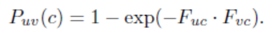
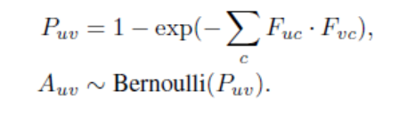
CESNA summary – 4/14
CESNA How to generate E in G?
How to design a likelihood function -> edge probability
Nodes u, v belonging to a community c are connected with probability:
B => G(E),
12
Notes:
Now we only have community affiliation weight Fuc. How should we design a likelihood function that is based on this affiliation weight to represent an edge probability in the graph G would become a question.
The authors define the edge probability like the
*
Template-WSU Hrz 431 gradation.ppt
13

Slide 14
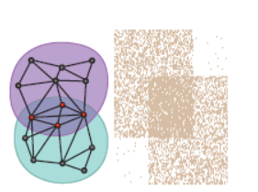
CESNA summary – 5/14
CESNA Why this modeling (E) is correct?
the more communities a pair of nodes shares,
the more likely they are connected.
$$°$$
Reprinted figure from [5]
This phenomenon is supported by [6],[7] (overlapping communities)
13
Notes:
The reason to define edge probability like this：
Defined like this, the more communities a pair of nodes shares, the more likely they are connected in the network
In the real-world, assume you and I are very active in the social network, and we join in the same set of communities. Then we are more likely connected in the social network, that there is an edge between us.
It looks like the figure that people in the overlapping region will be connected in a denser way compared to two persons belonging to different communities.
*
Template-WSU Hrz 431 gradation.ppt
14

Slide 15
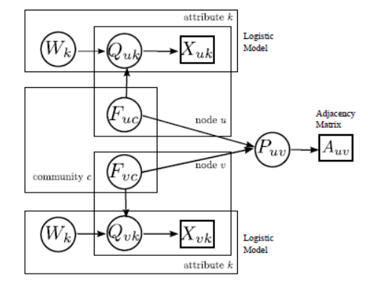
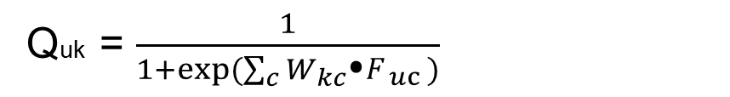
CESNA summary – 6/14
CESNA How to model Attribute values in G
Quk = $\frac{1}{1+exp⁡(\sum_{c}{{W_{kc}\text{⦁}F}_{uc })}}$
Quk : Probability that Xuk =1
Xuk ~ Bernoulli(Quk)
Reprinted figure from [3]
14
Notes:
Similarly, based on node’s community memberships, predict the value of each of the node’s attribute values.
Group memberships Fu1, …, FuC and feed them into a logistic model with weight factor Wkc for each attribute k and community c
Then the logistic model will calculate the probability that the attribute k for node u equals to 1.
Here, the authors have a strong assumption that the attribute value are binary attributes. Hence, for each node u at attribute k, they can comply with Bernoulli distribution.
Until now, we finish the task about how to model the attributed network.
*
Template-WSU Hrz 431 gradation.ppt
15

Slide 16
CESNA summary – 7/14
CESNA – how to find the latent optimal variables of F,W?
Maximizing the likelihood L(F,W) = log P(G,X|F,W) of the observed data G, X:
Gradient ascent approach => F and W
15
Notes:
Then we can use gradient ascent approach to update the latent variables F and W.
*
Template-WSU Hrz 431 gradation.ppt
16

Slide 17
CESNA summary – 8/14
CESNA – Gradient ascent approach
(1) Update Fu for each node u by fixing both W and the community membership Fv of all other nodes v.
Fu is a vector {Fuc} for node u
(2) Update logistic model parameter W by keeping community memberships F fixed.
Stopping criteria is that the likelihood does not increase (e.g. 0.001%) after a full iteration over all Fu and all Wk
16
Notes:
Derivation
Then, here we finish the latent variable learning. The remaining problem becomes how to assign a node’s community based on the affinity weight learned by this bipartite graph.

Slide 18
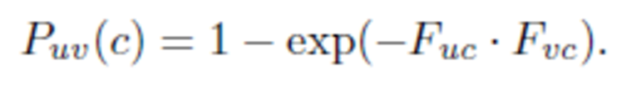
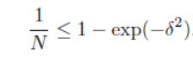
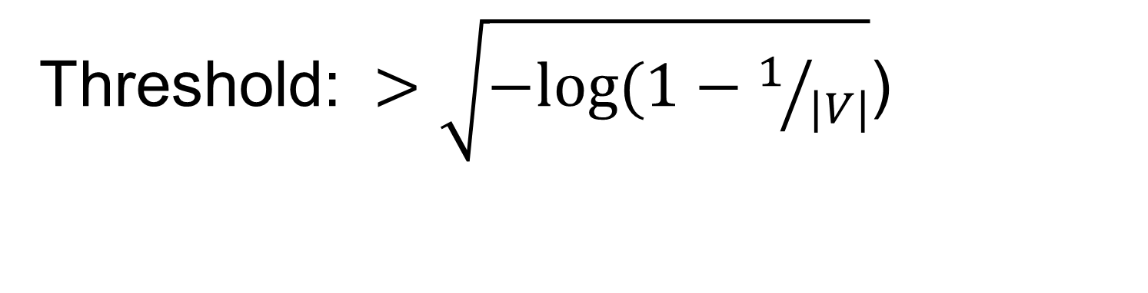
CESNA summary – 9/14
CESNA – How to assign a community to node u?
Threshold: $>\sqrt{−log⁡(1−1/{|V|}}$)
17

Slide 19
CESNA summary – 10/14
Dataset description and Baselines:
5 real-world dataset with ground-truth labels
Baselines: Considers only topology Demon[8] BigCLAM[5]
Considers only attributes MAC[3]
Considers both topology and node attributes
Block-LDA[9], CODICIL[4], EDCAR[10], Circles[11]
18
Notes:
5 datasets Facebook. Google+, Twitter, Philosophers, Flickr.

Slide 20
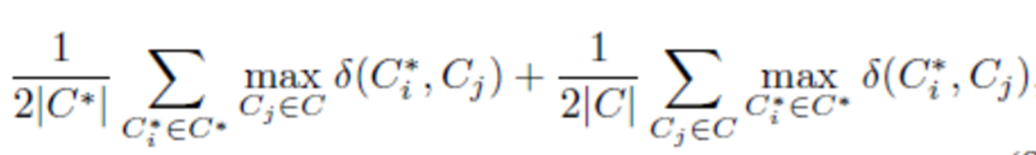
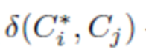
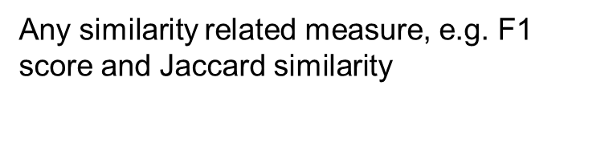
CESNA summary – 11/14
Evaluation metric:
Idea: quantify the agreement between C*, C
Also used in [14]
Any similarity related measure, e.g. F1 score and Jaccard similarity
The larger the value is, the better recovery of GT communities!
19
Notes:
$C^{∗}$ ground-truth communities
\delta(C*,C) needs a score between 0 and 1.

Slide 21
CESNA summary – 12/14
Experiment Result:
On 5 datasets, 2 similarity-related functions
CESNA yields the best performance in 8 out 10 cases
Outperforms Demon by 20%
BigCLAM by 6%
MAC by 112%
Block-LDA by 58%
CODICIL by 29%
EDCAR by 57%
Circles by 54%
Scalability:
Youtube dataset 2,509,862 edges and 129,907 nodes, 8 attributes
2 hours cannot return the result
20
Notes:
5 datasets Facebook. Google+, Twitter, Philosophers, Flickr.

Slide 22
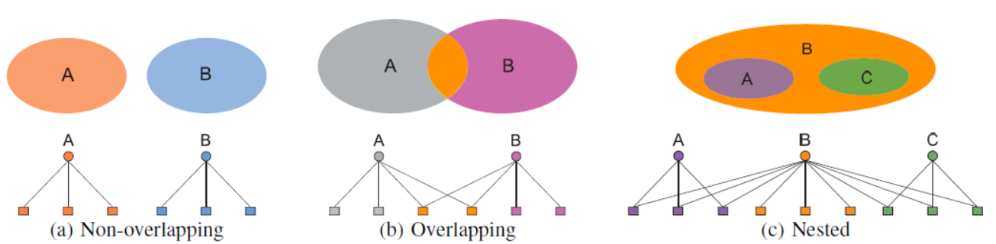
CESNA summary – 13/14
CESNA- advantages:
Rich modeling communities:
$$°$$
Reprinted figure from [3]
21
Notes:
Each membership Fuc of a node u is regarded as an independent variable to allow a node to belong to multiple communities simultaneously.
The advantage of using affiliation weights and bipartite graph for rich modeling of network communities
*
Template-WSU Hrz 431 gradation.ppt
22

Slide 23
CESNA summary – 14/14
CESNA - Limitations
(1) Interpretability
(2) Attribute value: binary too strong!!!
(3) Scalability with a limited resource (time budget, etc.)
(4) Require all the nodes sharing the same set of attributes
22
Notes:
Then, recall our three challenges,
In one mined community, there are edges between nodes in the network, how to properly explain this connection using attribute information?

Slide 24
Outline
Introduction
Paper summary(CESNA[1])
Survey on community detection in attributed networks
Attribute-driven backbone discovery
Conclusion
23
Notes:
*
Template-WSU Hrz 431 gradation.ppt
24

Slide 25
Survey – 1/6
Community Detection in Attributed Networks
Three main categories
Similarity/distance measurement-based
(Define similarity/distance measurement,
Clustering algorithm)
(2) Augmented graph-based
(attributes are served as additional topological information)
(3) Interaction model learning-based
24
Notes:
Classify them into three main categories based on methodological principles:
(topological information and vertex attribute are merged together into a global similarity/distance measurement. Then, any classical clustering algorithm can be further utilized)

Slide 26

Survey – 2/6
Similarity/distance measurement-based approach
25
Notes:
Define a similarity/distance measure between node attributes
-> weight on existing edges [6,7]
If original graph is weighted, then two weights can be merged.
Then structural distance and node attribute distance will be combined in the distance-based clustering method.
Community => nodes are not only well connected but also similar

Slide 27
Survey – 3/6
Pros:
Easy to understand
Supported by well-established clustering methods
Cons:
missing links or erroneous links => bad performance
Applications:
[12] Topic mining in academia network
26
Notes:
Take into consideration only vertices that are directly connected.
Vertices that are not directly connected in the graph have similarity 0 regardless of their attribute values [6,7].
In order to unify two types of distance functions, the function needs to be hand-designed and only applicable to certain applications.
E.g.
Bad performance result when the graph is expected to have certain missing links or erroneous links.

Slide 28
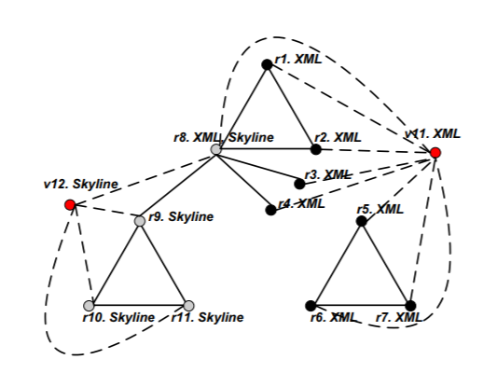
Survey – 4/6
Augmented graph-based approach
New common neighbors updated, e.g. r1 and r5 become closer
Distance value updated
Clustering methods
27
Notes:
V11, V12 (Attribute values) added to the graph, and they choose specific attributes.
Dash lines

Slide 29
Survey – 5/6
Augmented graph-based approach
Pros:
Iteratively refine the clusters (Random walk, adjust weight of attributes [8])
Cons:
Limited to small networks with few attribute values.
Scalability is poor when the graph or the attribute size is huge.
Applications:
[13]. Topic clustering in citation network
28

Slide 30
Survey – 6/6
Interaction model learning-based
[1] CESNA falls into this category
Applications:
Attribute representation in social network [1]
29

Slide 31
Outline
Introduction
Paper summary
Survey on community detection in attributed networks
Attribute-driven backbone discovery
Conclusion
30
Notes:
*
Template-WSU Hrz 431 gradation.ppt
31

Slide 32
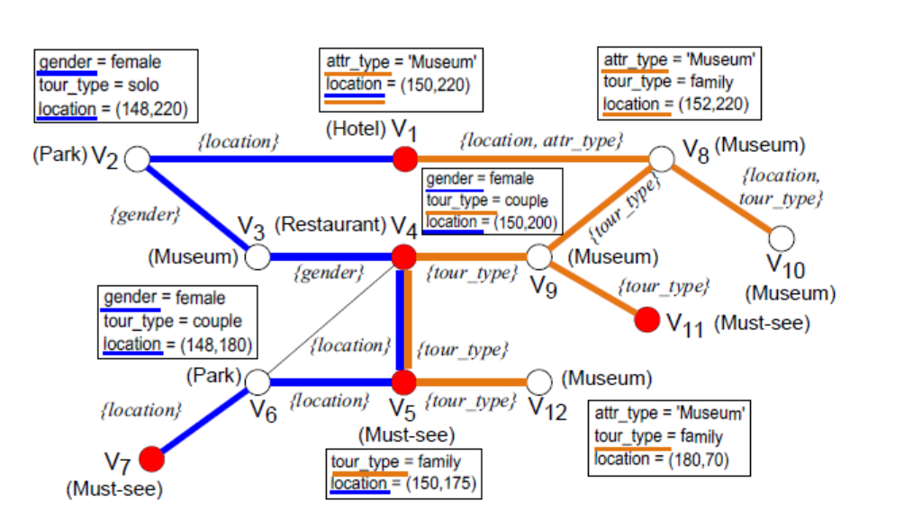
Attribute-driven backbone discovery
Motivation
31
Notes:
Backbone :
Each edge and its semantic is dynamically determined by specific attributes and values from its end nodes
Attribute information provides intuitive interpretation for the backbone structures.
The significance of T vary due to different focus of preference reflected by specific attributes and values
Personalized trip recommendation aims to compute backbone T that spans a set of attractions (marked by red nodes) with a root v1.

Slide 33
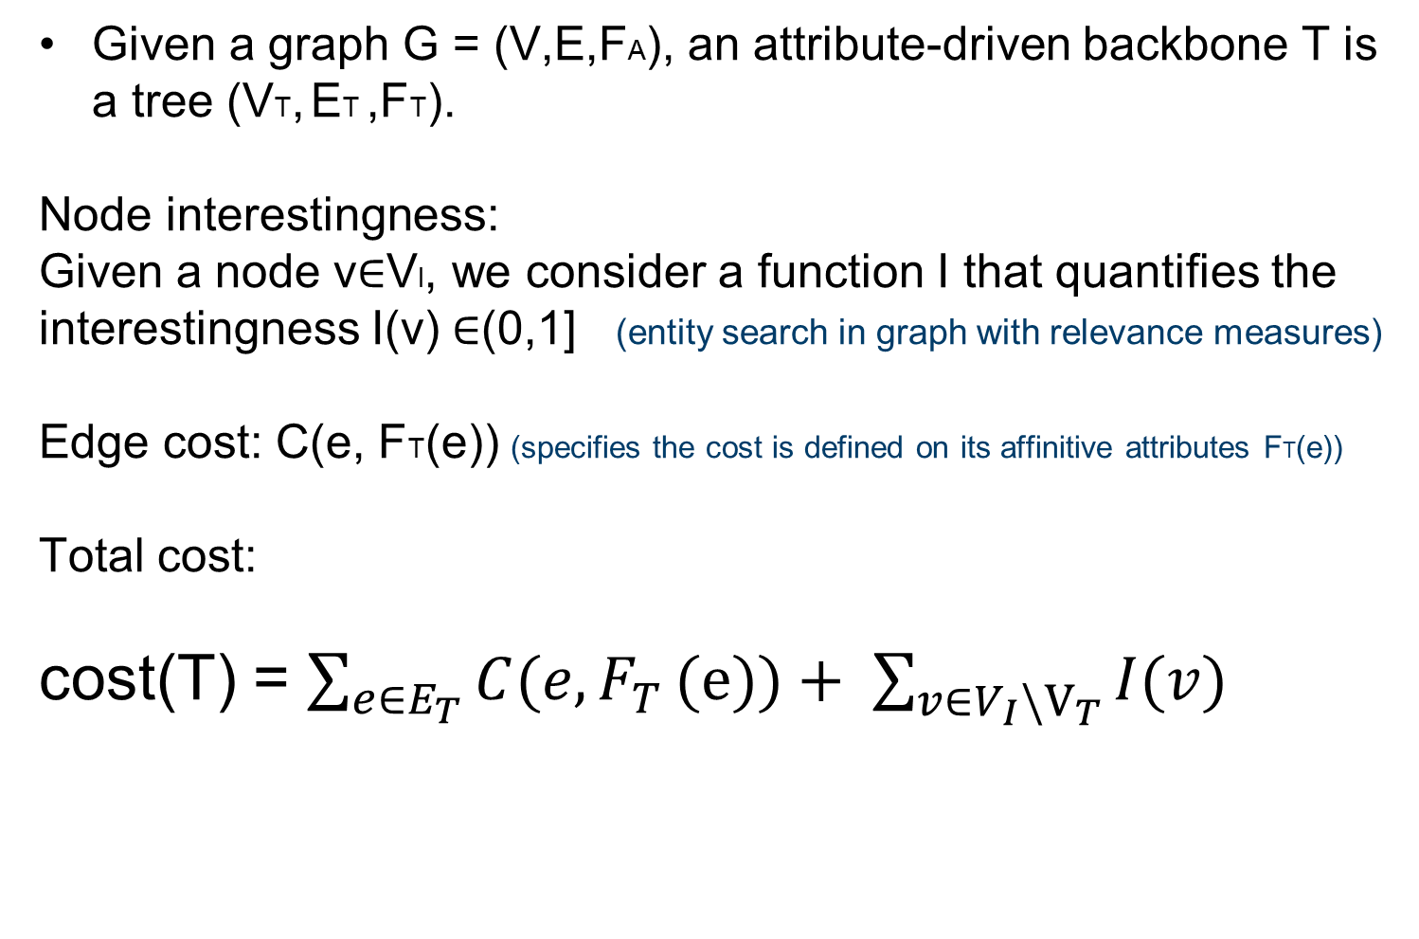
Attribute-driven backbone discovery
Cost model: Attribute-driven Backbone
Given a graph G = (V,E,FA), an attribute-driven backbone T is a tree (VT, ET ,FT).
Node interestingness:
Given a node v$∈$VI, we consider a function I that quantifies the interestingness I(v) $∈$(0,1] (entity search in graph with relevance measures)
Edge cost: C(e, FT(e)) (specifies the cost is defined on its affinitive attributes FT(e))
Total cost:
cost(T) = $\sum_{e∈E_{T}}{C(e,F_{T}}(e))+ \sum_{v∈V_{I}{\backslash V}_{T}}{I(v) }$
32

Slide 34
Attribute-driven backbone discovery
Cost model: Attribute-driven Backbone
When cost C(e, FT(e)) is given:
Prize-collecting Steiner Tree approach
(Approximation algorithm)
When cost C(e, FT(e)) is given:
EM- learning based approach
33

Slide 35
Outline
Introduction
Paper summary (CESNA[1])
Survey on community detection in attributed networks
Proposed research: Attribute-driven backbone discovery
Conclusion
34
Notes:
*
Template-WSU Hrz 431 gradation.ppt
35
The whole presentation consist of 5 parts. The first part I will give a brief background introduction.

Slide 36
Conclusion
Necessary to consider attributed graph
Remaining 3 challenges not fully solved
Attributed backbone idea
35

Slide 37
References (1/2)
[1] Yang, Jaewon, Julian McAuley, and Jure Leskovec. "Community detection in networks with node attributes." 2013 IEEE 13th International Conference on Data Mining. IEEE, 2013.
[2] Jia, Caiyan, et al. "Node attribute-enhanced community detection in complex networks." Scientific reports 7.1 (2017): 2626.
[3] Streich, Andreas P., et al. "Multi-assignment clustering for Boolean data." Proceedings of the 26th annual international conference on machine learning. ACM, 2009.
[4] Ruan, Yiye, David Fuhry, and Srinivasan Parthasarathy. "Efficient community detection in large networks using content and links." Proceedings of the 22nd international conference on World Wide Web. ACM, 2013.
[5] Yang, Jaewon, and Jure Leskovec. "Overlapping community detection at scale: a nonnegative matrix factorization approach." Proceedings of the sixth ACM international conference on Web search and data mining. ACM, 2013.
[6] H. Li, Z. Nie, W.-C. Lee, L. Giles, J.-R. Wen, Scalable community discovery on textual data with relations, CIKM, 2008
[7] H. Li, Z. Nie, W.-C. Lee, L. Giles, J.-R. Wen, Scalable community discovery on textual data with relations, CIKM, 2008
[8] H. Li, Z. Nie, W.-C. Lee, L. Giles, J.-R. Wen, Scalable community discovery on textual data with relations, CIKM, 2008
[9] J. Neville, M. Adler, D. Jensen, Clustering relational data using attribute and link information, in: Proceedings of the text mining and link analysis workshop, 18th international joint conference on artificial intelligence, 2003
[8] Zhou, Yang, Hong Cheng, and Jeffrey Xu Yu. "Graph clustering based on structural/attribute similarities." Proceedings of the VLDB Endowment 2.1 (2009): 718-729.
[9] H. Cheng, Y. Zhou, J. X. Yu, Clustering large attributed graphs: A balance between structural and attribute similarities, ACM Transactions on Knowledge Discovery from Data (TKDD) 5 (2011)
[10] B. H. Good, Y.-A. de Montjoye, A. Clauset, Performance of modularity maximization in practical contexts, Physical Review E 81 (2010)
[11] A. Lancichinetti, S. Fortunato, Limits of modularity maximization in community detection., Physical Review E 84 (2011)

Slide 38
References (2/2)
[10] Yang, Jaewon, Julian McAuley, and Jure Leskovec. "Community detection in networks with node attributes." 2013 IEEE 13th International Conference on Data Mining. IEEE, 2013.
[11] Jia, Caiyan, et al. "Node attribute-enhanced community detection in complex networks." Scientific reports 7.1 (2017): 2626.
[12] Streich, Andreas P., et al. "Multi-assignment clustering for Boolean data." Proceedings of the 26th annual international conference on machine learning. ACM, 2009.
[13] Ruan, Yiye, David Fuhry, and Srinivasan Parthasarathy. "Efficient community detection in large networks using content and links." Proceedings of the 22nd international conference on World Wide Web. ACM, 2013.

Slide 39
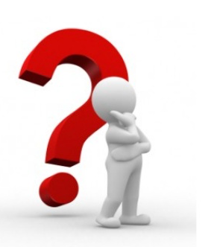
Questions

Slide 40
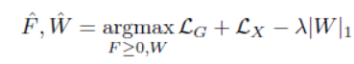
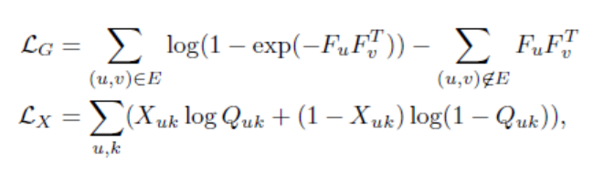
Paper summary – 1 (3/10)
CESNA
Maximizing the likelihood L(F,W) = log P(G,X|F,W) of the observed data G, X:
$$°$$
The regularization term is brought in to learn sparse relationships between community memberships and node attributes.
Then gradient ascent approach is used to update the latent variables F and W
Notes:
*
Template-WSU Hrz 431 gradation.ppt
40

Slide 41
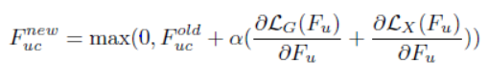
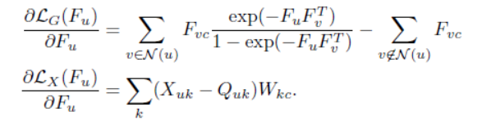
Paper summary – 1
CESNA – Gradient ascent approach
(1) Update Fu for each node u by fixing both W and the community membership Fv of all other nodes v.
Fu is a vector {Fuc} for node u
N(u) refers to neighborhood set of u in graph G. The purpose is to reduce the computation time from O(|V|) to O(|N(u)|)
Notes:
Derivation

Slide 42
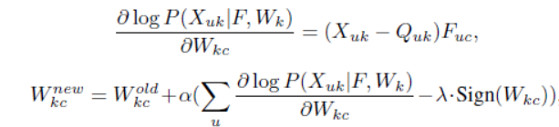
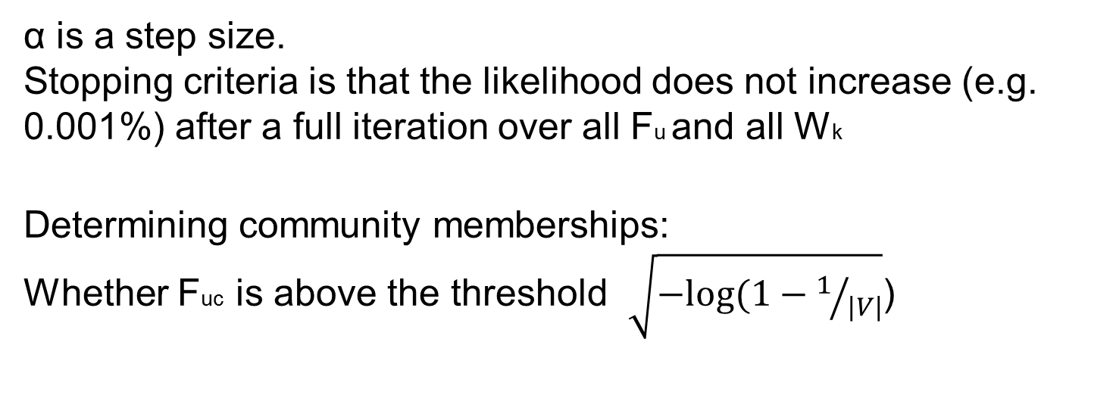
Paper summary – 1
CESNA
(2) Update logistic model parameter W by keeping community memberships F fixed.
α is a step size.
Stopping criteria is that the likelihood does not increase (e.g. 0.001%) after a full iteration over all Fu and all Wk
Determining community memberships:
Whether Fuc is above the threshold $\sqrt{−log⁡(1−1/{|V|}}$)

Slide 43
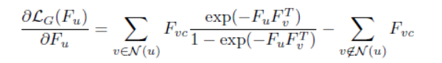
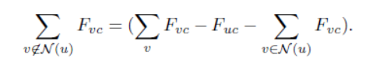
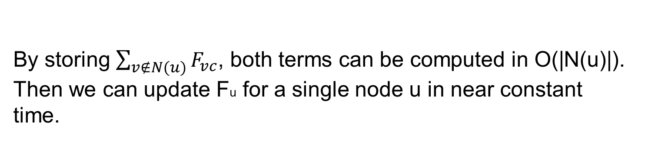
Paper summary – 1
CESNA
Speed up:
By storing $\sum_{v∉N(u)}{F_{vc}}$, both terms can be computed in O(|N(u)|).
Then we can update Fu for a single node u in near constant time.

Slide 44
Paper summary – 1 (3/10)
CESNA – automatically find the # of communities C
Reserve 10% node pairs in the adjacency matrix and node –attribute pairs as a holdout set
Varying C, learning the corresponding latent variables
Evaluate the likelihood based on the holdout et
The C that induces the maximum held-out likelihood will be chosen as the # of communities
Other hyper-parameter tuning held-out data (corss-validation)
$$°$$
Notes:
*
Template-WSU Hrz 431 gradation.ppt
44

Slide 45
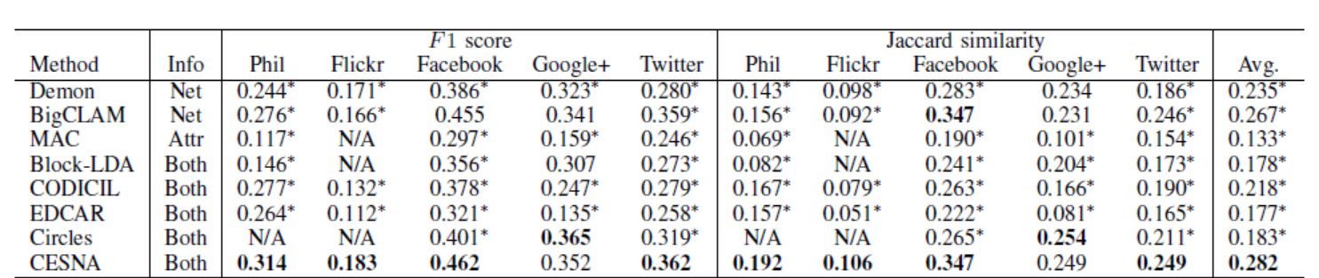
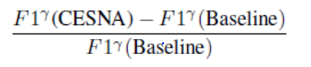
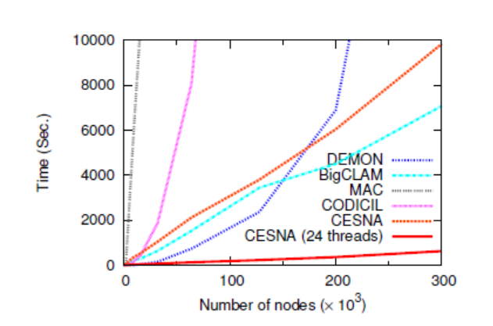
Paper summary – 1 (3/10)
Even though the network contains many missing edges, CESNA still outperforms other methods by better leveraging the information present in the node attributes.
Notes:
*
Template-WSU Hrz 431 gradation.ppt
45

Slide 46
Paper summary
What we have learned?
Considering both network structure and the node attributes can lead to more accurate community detection as well as improved robustness in the presence of noise in the network structure or node attributes [1].
There are still limitations in prior works on community detection in attributed graphs:
Interpretability
Interested nodes coverage
Scalability
Require a unified attribute set [1,6,7,8]

Slide 47
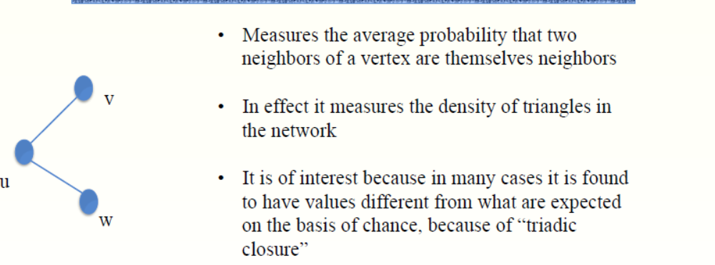
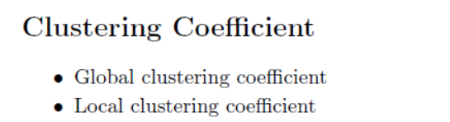
Topology feature
Clustering coefficient

Slide 48
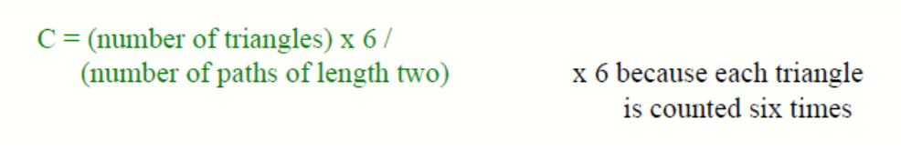
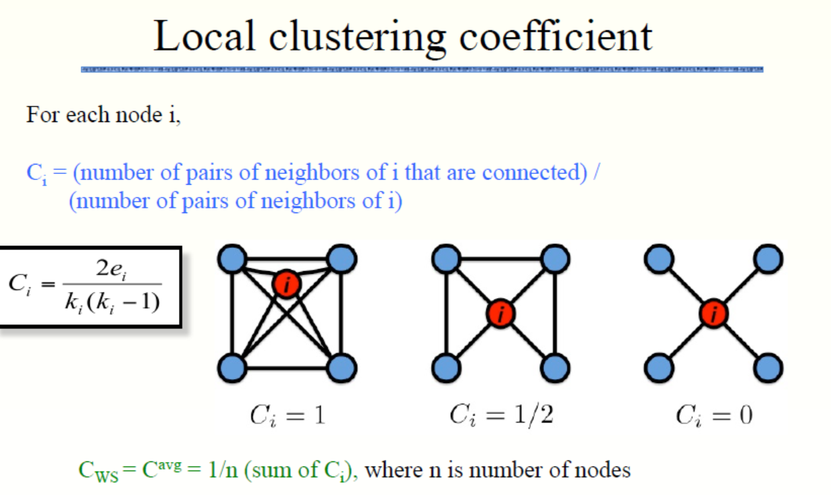

Slide 49
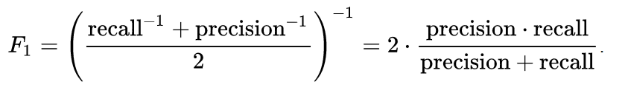
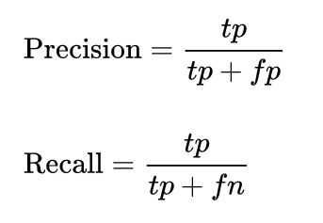
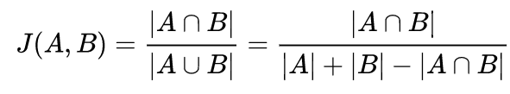
Common Metrics

Slide 50
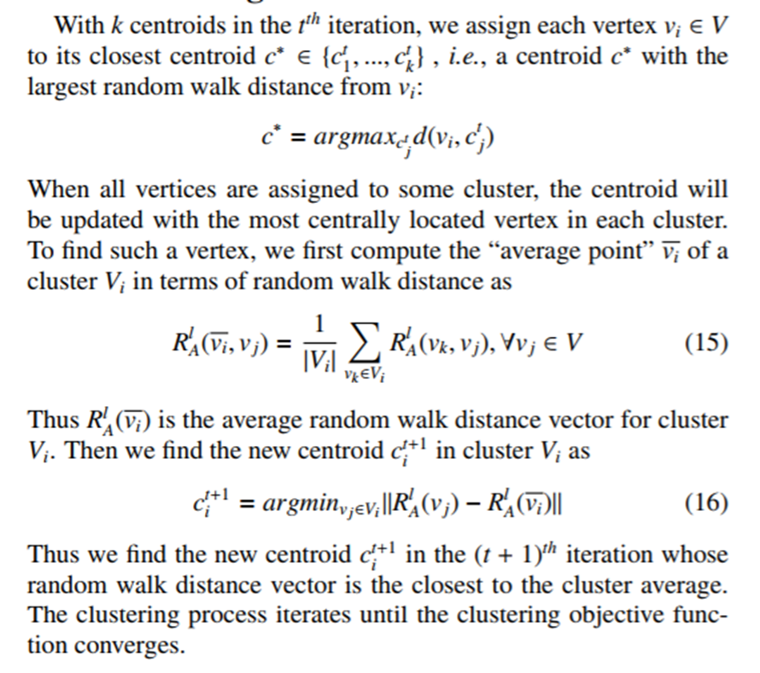
Clustering

Slide 51
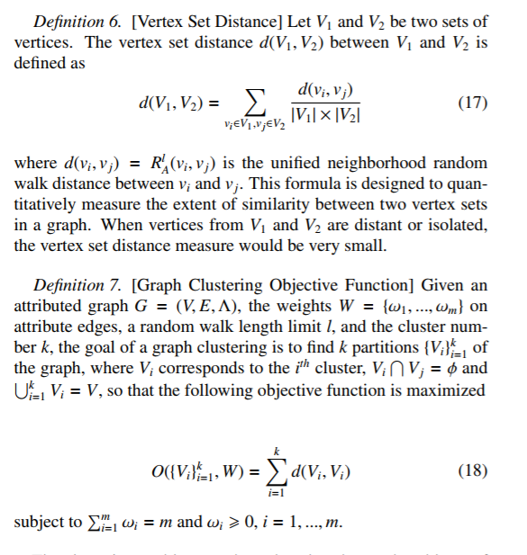
Clustering

Slide 52
Attribute-driven backbone discovery
Problem hardness result
The decision version of ABD problem is NP-complete. It is APX-hard as an optimization problem
See that ABD is in NP, we provide an NP problem that guesses a backbone with associated affinitive attributes, and verify its cost in polynomial time
Hardness can be verified by a reduction from minimum Steiner tree, that is a well-known NP-hard problem.
The hardness of approximation follows from an approximation ratio preserving reduction from minimum Steiner tree, which is also APX-hard.
The APX-hardness of ABD suggests that no polynomial-time algorithm can approximate the optimal backbone for arbitrary approximation ratio.
ABD is a fixed-parameter 2-approximable with fixed l =

Slide 53
Attribute-driven backbone discovery
What is attribute-driven backbone ?
Attribute-driven backbones can be captured by a weighted tree T = (VT, ET) that connects a set of attributed nodes VT, were each edge e = (v, v’) in T is associated with a set of affinitive node attributes A (both v and v’ have values in A)
Attributed-driven backbone discovery (ABD)
Input: Attributed graph G, a set of interested nodes VI in G, an interestingness function I, and an edge cost model C that assigns a weight to an edge given its affinitive attributes.
Output: at attributed backbone T that connects the nodes in VI with maximized interestingness in terms of I, and minimized edge cost in terms of C
Critical tree structure
Notes:
Edge cost model C is in a very general form.

Slide 54
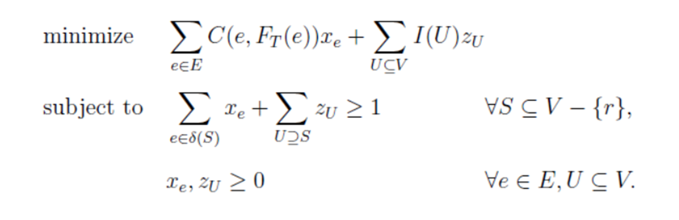


Attribute-driven backbone discovery
Problem Statement: Attribute-driven Backbone
Given a graph G with node set V, node interestingness measure I, edge cost model C, and a set of interested nodes VI $⊆$ V with a root node r,
The problem of ABD is to compute a valid attribute-driven backbone T with root r and has a minimum cost C(T).
zU denotes whether a node set U $⊂\text{V} \text{not} \text{containing} \text{root} \text{r} \text{is} \text{spanned} \text{by} \text{T}$
$δ(S)$ denotes the edges having exactly one endpoint in S $⊆$ V \ {r}

Slide 55

Attribute-driven backbone discovery

Slide 56
Attribute-driven backbone discovery
Comparison
Comparison with Attributed community detection:
Each edge has its own affinitive attributes
No predefined cost measurement function
Approximation algorithm with approximation guarantees
Some community detection methods works poorly in sparse network
Comparison with connection subgraph detection:
Connection subgraph detection considers no attributes and assumes predefined edge weights
Keyword search in graphs:
Steiner-tree based structure returned by keyword search can be treated as a special case of ABD with single label, unit node weight or predefined edge weight.

